Slide 1
Lecture 13
The applications of tomography:
MCAO, MOAO, GLAO
Claire Max
AY 289
February 20, 2020

Slide 2
Outline of lecture
What is AO tomography?
Applications of AO tomography
  Laser tomography AO (LTAO)
  Multi-conjugate AO (MCAO)
  Multi-object AO (MOAO)
  Ground-layer AO (GLAO)
Much of this lecture is based on presentations by Don Gavel, Lisa Poyneer, Francois Rigaut, and Olivier Guyon. Thanks!

Slide 3
Limitations for AO systems with one guide star
Isoplanatic Angle
  Limits the corrected field
r0
h
θ0
3
Notes:
3

Slide 4
Limitations for AO systems with one guide star
Cone effect
4
Notes:
4

Slide 5
Limitations for AO systems with one guide star
Cone effect
  Missing turbulence outside and above cone
  Spherical wave “stretching” of wavefront
More severe for larger telescope diameters
r0
h
5
Notes:
5

Slide 6
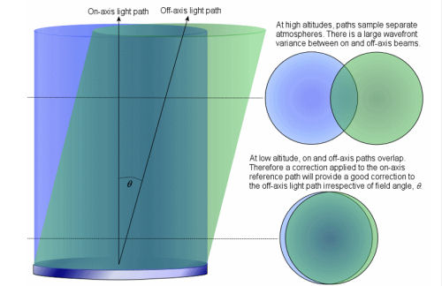
Fundamental problem to solve: Isoplanatic Angle
If we assume perfect on-axis correction,
and a single turbulent layer at altitude h,
the variance (sq. radian) is :
σ² = 1.03 (θ/θ₀)^{5/3}
Θ = angle to optical axis,
θ₀ = isoplanatic angle:
θ₀ = 0.31 (r₀/<h>)
D = 8 m, r₀ = 0.8 m,
<h> = 5 km => θ₀ = 10”
h

Slide 7
Francois Rigaut’s diagrams of tomography for AO
90 km
“Missing” Data
Credit: Rigaut, MCAO for Dummies

Slide 8
What is Tomography ?
2. Wider field of view, no cone effect
Tomography lets you reconstruct turbulence in the entire cylinder of air above the telescope mirror
90 km
Credit: Rigaut, MCAO for Dummies

Slide 9
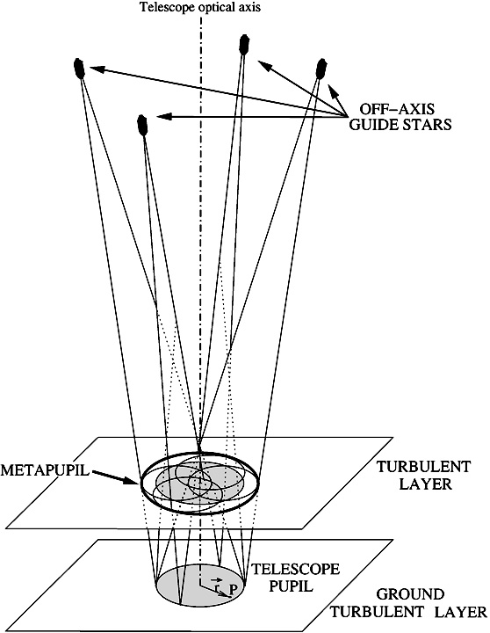
Concept of a metapupil
Can be made larger than “real” telescope pupil
Increased field of view due to overlap of fields toward multiple guide stars

Slide 10
How tomography works: from Don Gavel
kZ
kX
Fourier Transform
x - z plane
kx - kz plane
Fourier slice theorem in tomography
(Kak, Computer Aided Tomography, 1988)
Each wavefront sensor measures the integral of index variation along the ray lines
The line integral along z determines the kz=0 Fourier spatial frequency component
Projections at several angles sample the kx,ky,kz volume
10
Notes:
10

Slide 11
How tomography works: from Don Gavel
kZ
kX
Fourier Transform
x - z plane
kx - kz plane
The larger the telescope’s primary mirror, the wider the range of angles accessible for measurement
In Fourier space, this means that the “bow-tie” becomes wider
More information about the full volume of turbulence above the telescope
11
Notes:
11

Slide 12
How tomography works: some math
where
  y = vector of all WFS measurements
  x = value of δ(OPD) at each voxel in turbulent volume above telescope
x
y
  A is a forward propagator
Assume we measure y with our wavefront sensors
Want to solve for x = value of δ(OPD)
The equations are underdetermined – there are more unknown voxel values than measured phases ⇒ blind modes. Need a few natural guide stars to determine these.
Notes:
12

Slide 13
Solve for the full turbulence above the telescope using the back-propagator
x
  y = vector of all WFS measurements
  x = value of δ(OPD) at each voxel in turbulent volume above telescope
y
  A^{T} is a back propagator along rays back toward the guidestars
x
  Use iterative algorithms to converge on the solution.
y
Notes:
13

Slide 14
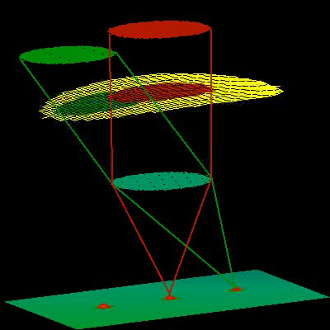
LGS Related Problems: “Null modes”
Tilt Anisoplanatism : Low order modes produce Tip-Tilt at altitude
  → Dynamic Plate Scale changes
Five “Null Modes” are not seen by LGS (Tilt indetermination problem)
Need 3 well spread tip-tilt stars to control these modes
Credit: Rigaut, MCAO for Dummies

Slide 15
Outline of lecture
Review of AO tomography concepts
AO applications of tomography
  Laser tomography AO (LTAO)
  Multi-conjugate AO (MCAO)
  Multi-object AO (MOAO)
  Ground-layer AO (GLAO)

Slide 16
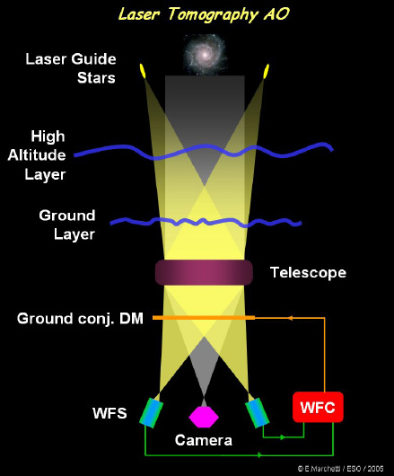
Laser Tomography AO: High-Order Correction; Fixes Cone Effect
Corrected field: 10’s of arc sec
one DM
Narrow field,
cone effect fixed

Slide 17
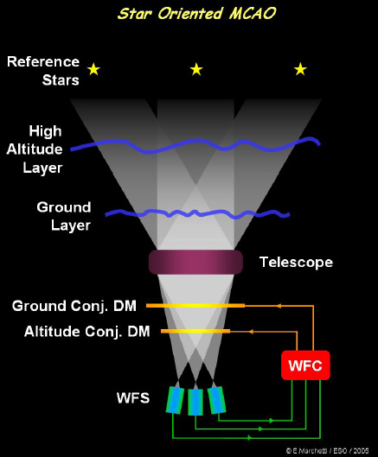
Multi-Conjugate AO: Wider Field Correction
Corrected field: up to ~2 arc min
≥ 2 DMs
Corrects over wider field,
at a penalty in peak Strehl

Slide 18
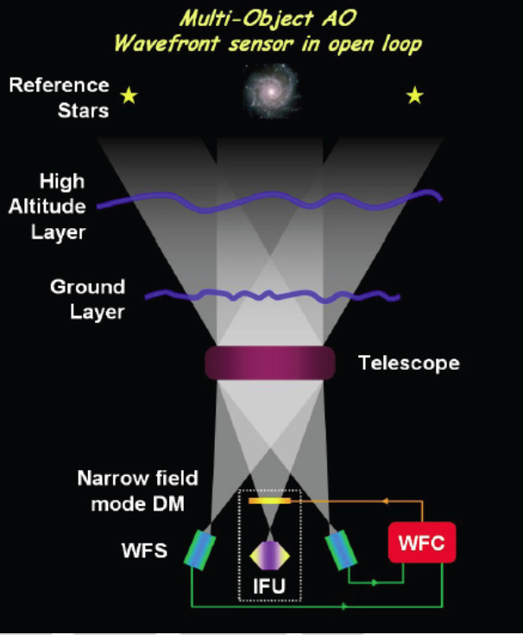
Multi-Object AO: Wider Field but only correct objects you are interested in
Corrected field:
N x 10’s of arc sec
One DM for each object of interest
Multiple Narrow Field DMs
Correct over narrow field of view located anywhere w/in wide field of regard

Slide 19
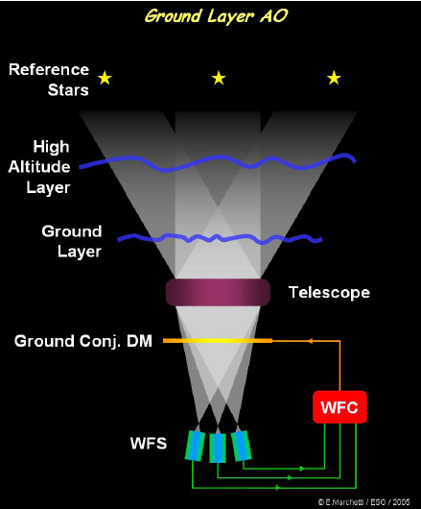
Ground Layer AO: Widest field, only modest AO correction
Corrected field:
5 -10 arc min
One DM conjugate to ground
Quite modest correction over a much wider field of view

Slide 20
Corrected fields of view vary depending on method
Method |  | Corrected field of view
Laser Tomography AO | LTAO | 10’s of arc sec
Multi-Object AO | MOAO | N x 10’s of arc sec
Multi-Conjugate AO | MCAO | ≤ about 2 arc min
Ground Layer AO | GLAO | A few to 10 arc min

Slide 21
Outline of lecture
Review of AO tomography concepts
AO applications of tomography
  Multi-conjugate adaptive optics (MCAO)
  Multi-object adaptive optics (MOAO)
  Ground-layer AO (GLAO)

Slide 22
What is multiconjugate AO?
Turbulence Layers
Deformable mirror
Credit: Rigaut, MCAO for Dummies

Slide 23
What is multiconjugate AO?
Deformable mirrors
Turbulence Layers
Credit: Rigaut, MCAO for Dummies

Slide 24
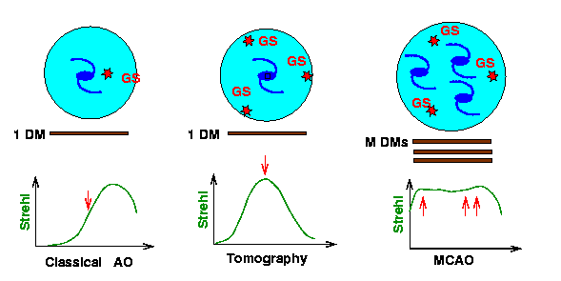
Difference between Laser Tomography AO and MCAO
Laser Tomography AO can be done with only 1 deformable mirror
If used with multiple laser guide stars, reduces cone effect
MCAO uses multiple DMs, increases field of view

Slide 25
“Star Oriented” MCAO
Each WFS looks at one star
Global Reconstruction
n GS, n WFS, m DMs
1 Real Time Controller
Guide Stars
High Altitude Layer
Ground Layer
The correction applied at each DM is computed using all the input data.
Telescope
DM2
DM1
WFC
WFSs
Credit: N. Devaney

Slide 26
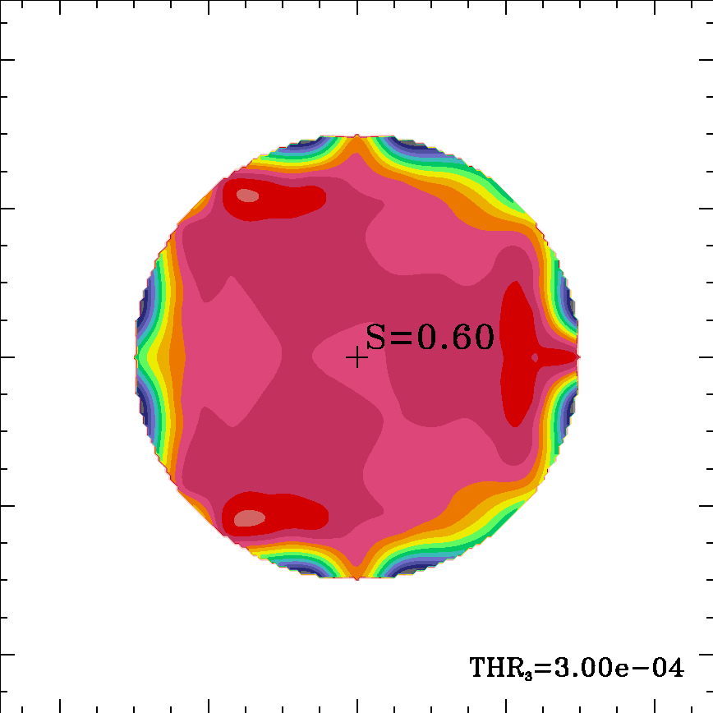
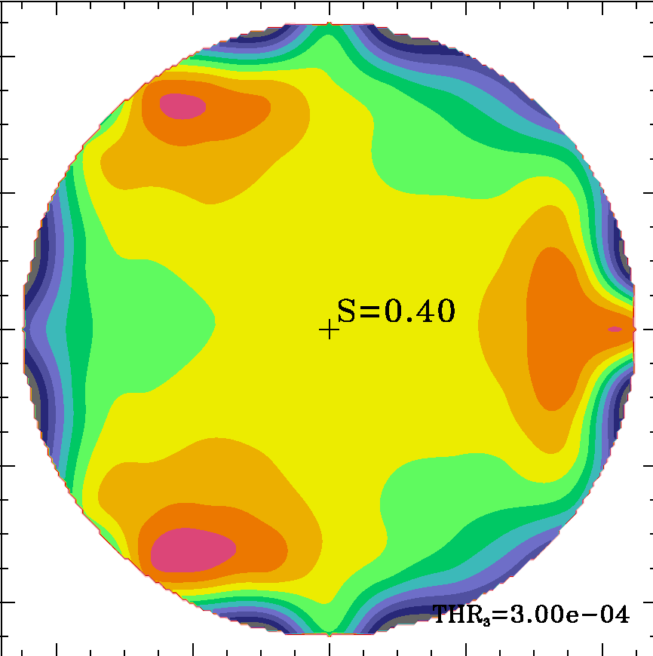

MCAO Simulations, 3 guide stars
Strehl at 2.2 μm
3 guide stars,
FoV = 1 arc min
3 guide stars,
FoV = 1.5 arc min
Optimum guide star separation:
about one isoplanatic angle
Credit: N. Devaney

Slide 27
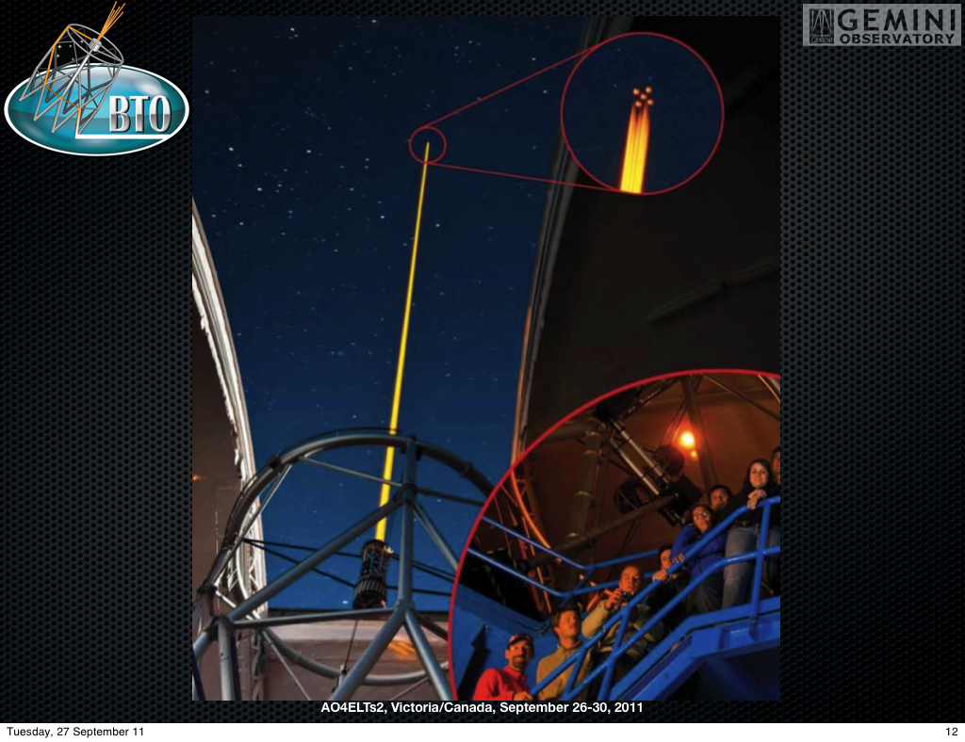
First operational MCAO system:
GEMS at Gemini South 8m telescope

Slide 28
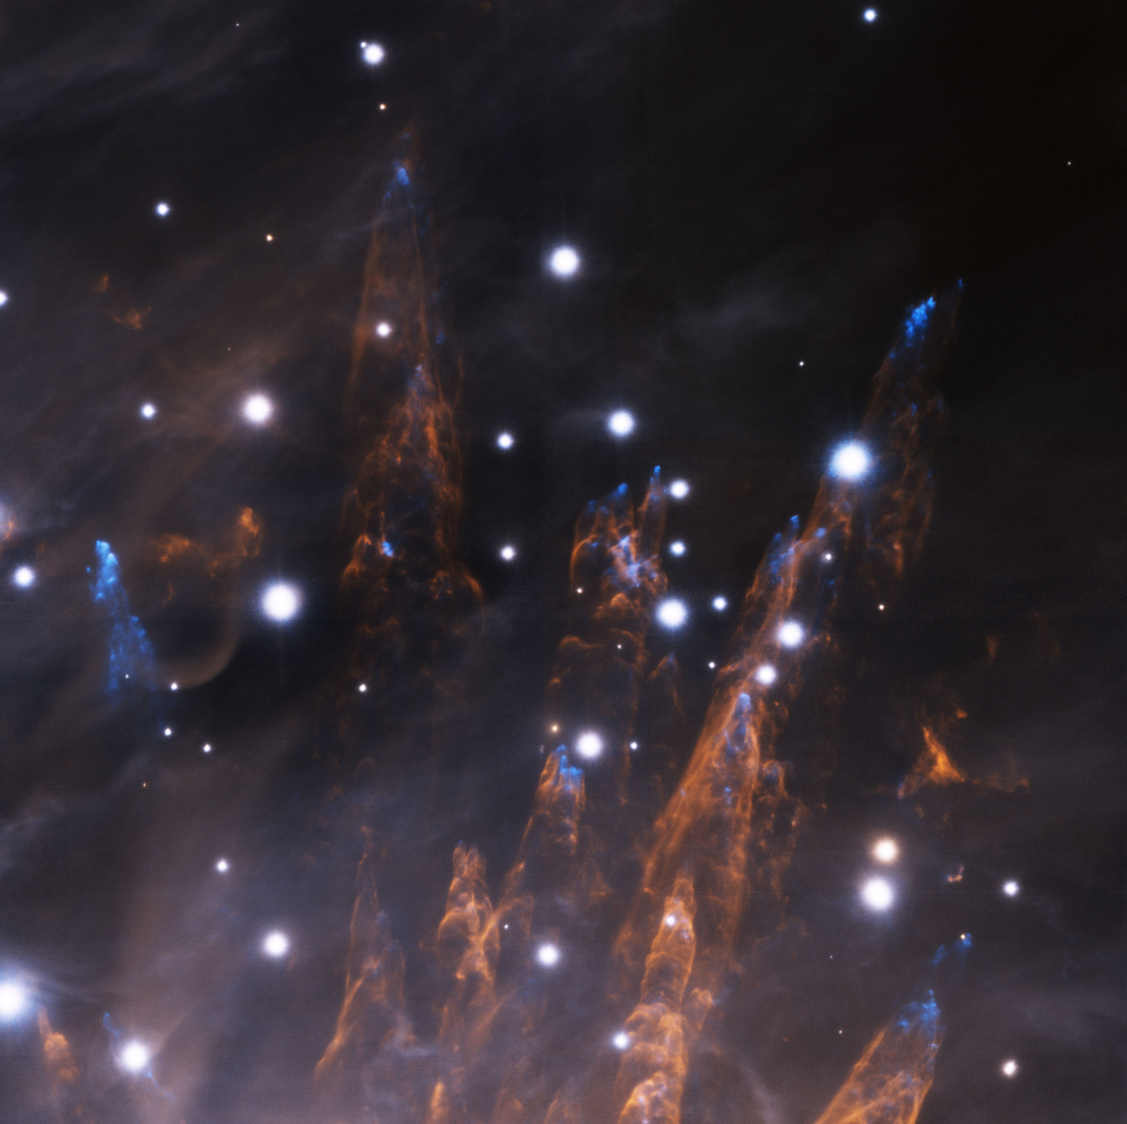
GEMS image of star formation in Orion

Slide 29
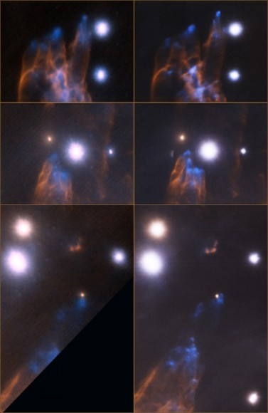
Orion star forming region:
Compare GEMS MCAO with ALTAIR single conjugate AO on Gemini North Telescope
ALTAIR GEMS

Slide 30
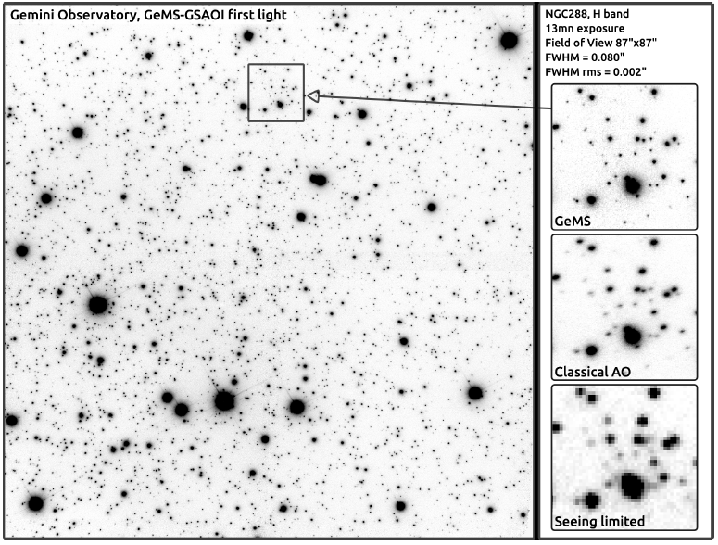
GEMS MCAO: very good uniformity across 87” x 87” field
Credit:
Rigaut et al.
2013

Slide 31
Outline of lecture
Review of AO tomography concepts
AO applications of tomography
  Multi-conjugate adaptive optics (MCAO)
  Multi-object adaptive optics (MOAO)
  Ground-layer AO (GLAO)

Slide 32
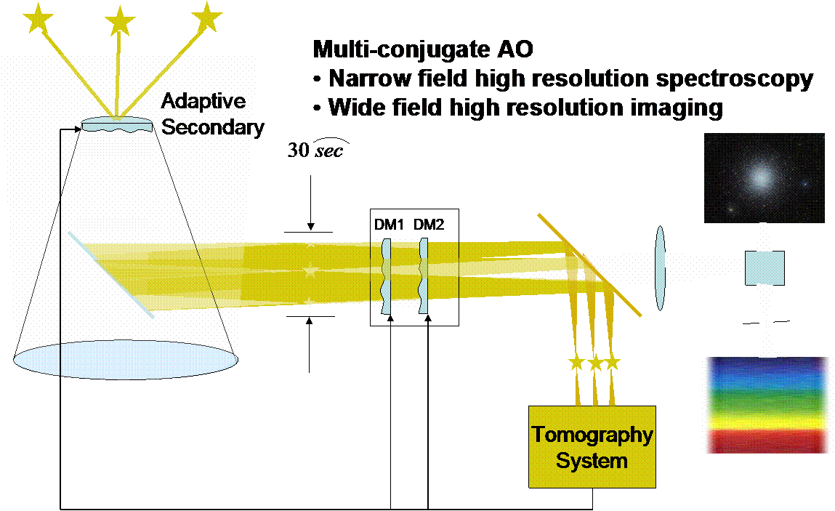
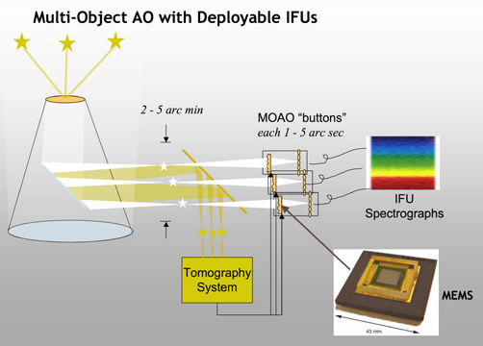
Distinctions between multi-conjugate and multi-object AO
Closed-Loop
Open-Loop
?
1-2 arc min
DMs conjugate to different altitudes in the atmosphere
Guide star light is corrected by DMs before its wavefront is measured
Only one DM per object, conjugate to ground
Guide star light doesn’t bounce off small MEMS DMs in multi-object spectrograph

Slide 33
Multi-Object AO
Correct over multiple narrow fields of view located anywhere w/in wide field of regard
In most versions, each spectrograph or imager has its own MEMS AO mirror, which laser guide star lights doesn’t bounce off of
Hence this scheme is called “open loop”: DM doesn’t correct laser guide star wavefronts before LGS light goes to wavefront sensors
In one version, each LGS also has its own MEMS correction

Slide 34
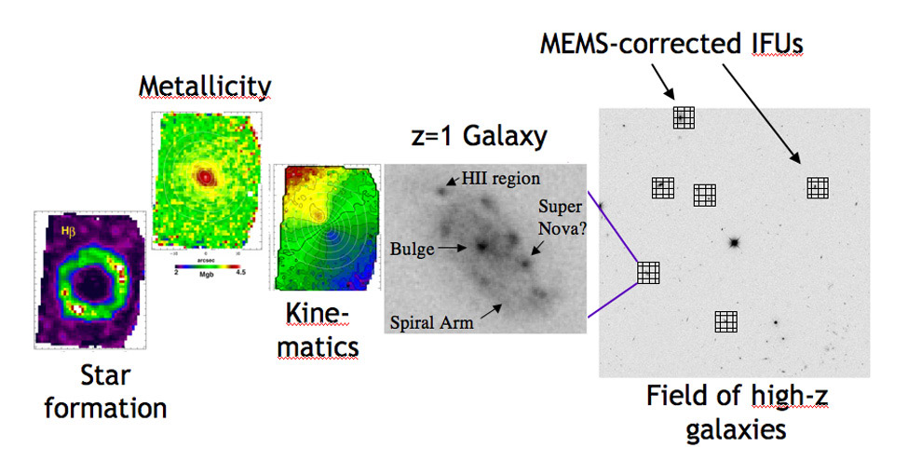
Science with MOAO: multiple deployable spatially resolved spectrographs
A MEMS DM underneath each high-redshift galaxy, feeding a narrow-field spatially resolved spectrograph (IFU)
No need to do AO correction on the blank spaces between the galaxies

Slide 35
Why does MOAO work if there is only one deformable mirror in the science path?
Tomography lets you measure the turbulence throughout the volume above the telescope
90 km

Slide 36
Why does MOAO work if there is only one deformable mirror in the science path?
Tomography lets you measure the turbulence throughout the volume above the telescope
In the direction to each galaxy, you can then project out the turbulence you need to cancel out for that galaxy
90 km

Slide 37
MOAO Demonstration Systems
CANARY (Durham, Obs. de Paris, ONERA, ESO)
  MOAO pathfinder for E-ELT
  On William Herschel Telescope
  First NGS, then Rayleigh guide stars
RAVEN (U Victoria, Subaru, INO, Canadian NRC)
  MOAO demonstrator for Subaru telescope
  3 NGS wavefront sensors
  Field of regard > 2.7 arc min

Slide 38
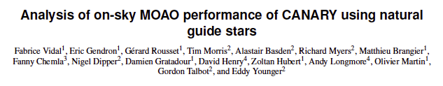
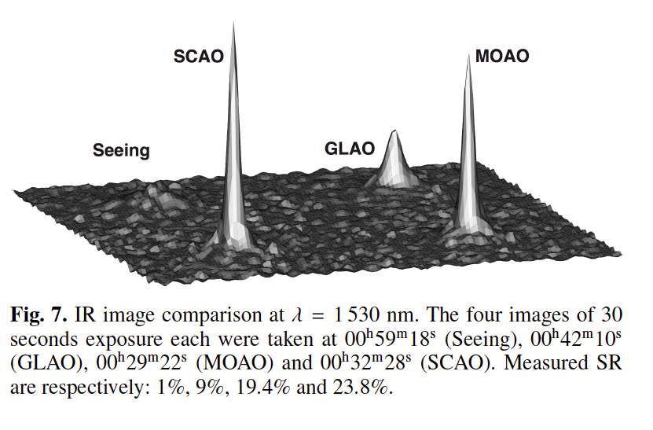

Slide 39
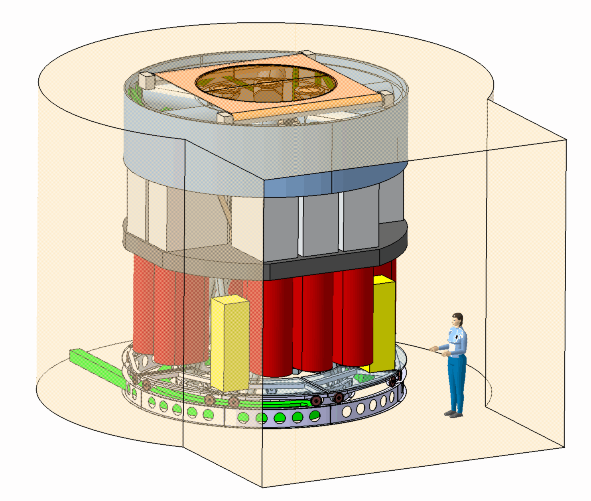
Both E-ELT and TMT have done early designs for MOAO systems
Artist’s sketch of EAGLE MOAO system for E-ELT
One of the constraints is that the spectrographs are very large!
Hard (and expensive) to fit in a lot of them

Slide 40
Outline of lecture
Review of AO tomography concepts
AO applications of tomography
  Multi-conjugate adaptive optics (MCAO)
  Multi-object adaptive optics (MOAO)
  Ground-layer AO (GLAO)

Slide 41
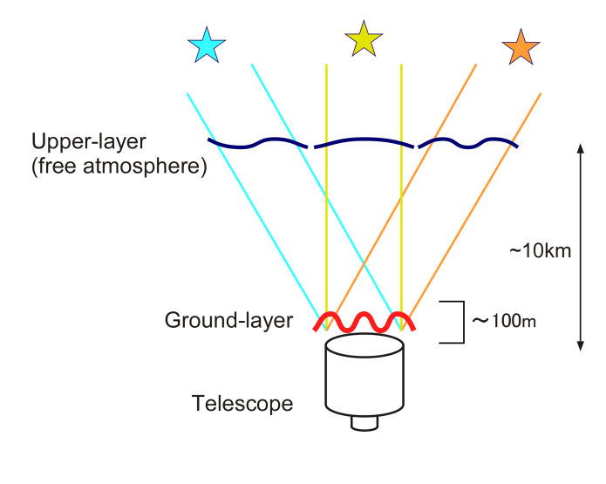
Ground layer AO: do tomography, but only use 1 DM (conjugate to ground layer)
Or instead of tomography, can just average over the guide stars
GLAO uses 1 ground-conjugated DM, corrects near-ground turbulence
Credit: J-M Conan

Slide 42
Correcting just the ground layer gives a very large isoplanatic angle
Strehl = 0.38 at θ = θ₀
θ₀ is isoplanatic angle
θ₀ is weighted by high-altitude turbulence (z^{5/3})
If turbulence is only at low altitude, overlap is very high.
If you only correct the low altitude turbulence, the isoplanatic angle will be large (but the correction will be only modest)
Common
Path
Telescope

Slide 43
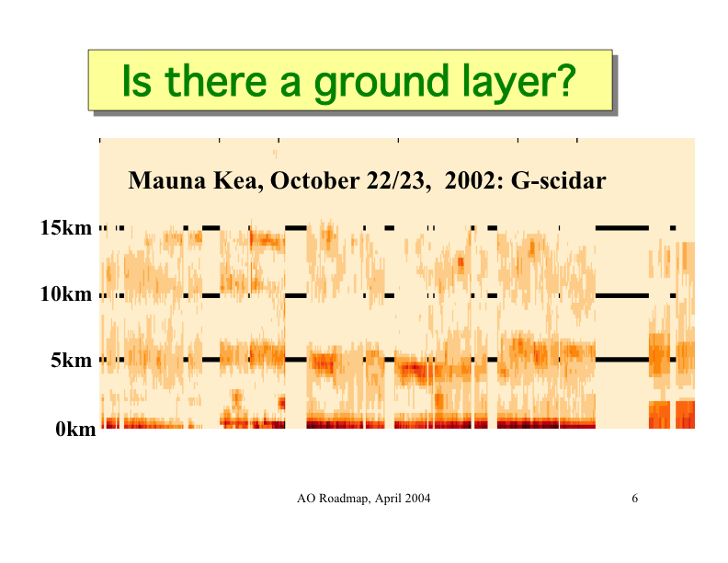

time
Credit: A. Tokovinin

Slide 44
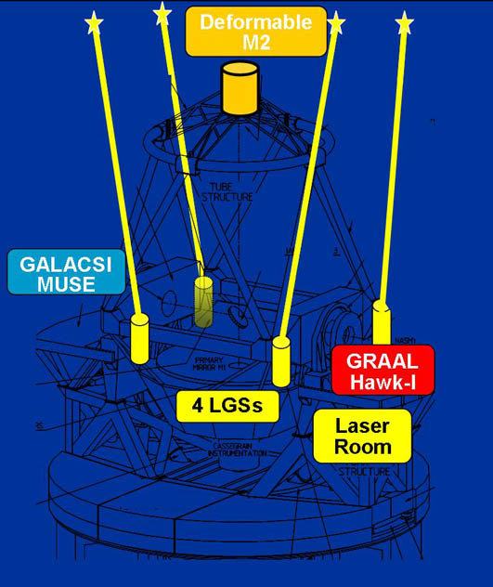
Several observatories have ambitious GLAO projects today
Early pathfinders: SOAR (4.25m), William Herschel Telescope (4.2m), MMT (6.5m)
Recently on VLT (8m), LBT (2x8m)
Longer term on Giant Magellan Telescope, E-ELT
Why is it worth the large investment “just” to decrease “seeing” disk by factor of 1.5 to 2 ?
  Large spectrographs can take advantage of smaller image (smaller slit)
  Potential improved SNR for background-limited point sources
  Less variability in PSF

Slide 45
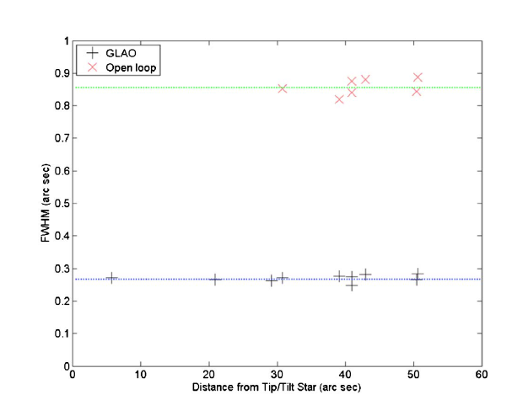
GLAO on the MMT Telescope
Michael Hart et al. , 5 Rayleigh laser guide stars
FWHM decreased from 0.85 arc sec to 0.28 arc sec (!)

Slide 46
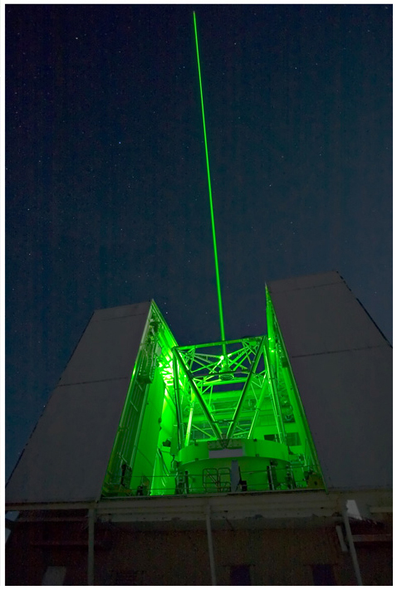
GLAO on the MMT Telescope
Michael Hart et al. , 5 Rayleigh laser guide stars

Slide 48
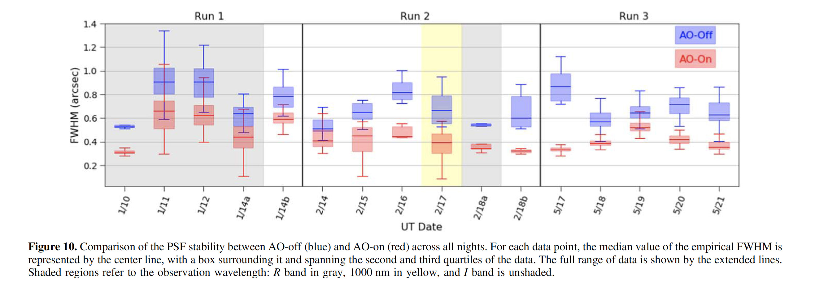
`Imaka: GLAO on UH 88” Telescope
Natural guide star constellation
GLAO reduces two things:
FWHM
Variability of FWHM

Slide 49
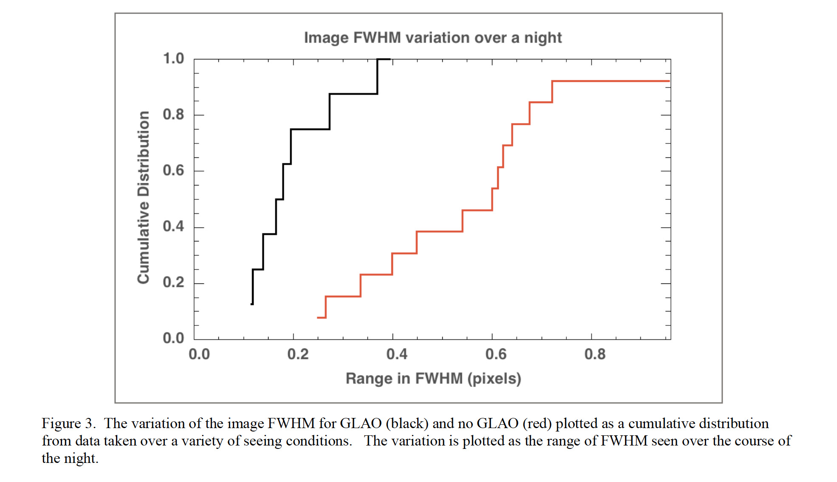
‘Imaka GLAO reduces PSF variability
GLAO
No GLAO

Slide 50
Summary
Tomography: a way to measure the full volume of turbulence above the telescope
Once you have measured the turbulence there are several ways to do the wavefront correction
  Laser Tomography AO: Multiple laser guide stars, 1 DM, corrects cone effect. Narrow field.
  Multi-conjugate AO: Multiple DMs, each optically conjugate to a different layer in atmosphere. Wider field of view.
  Multi-object AO: Correct many individual objects, each over a small field. Each has very good correction. Wider field of regard.
  Ground-layer AO: Correct just ground layer turbulence. Very large field of view but only modest correction.
All four methods will be used in the future

Slide 51
Corrected fields of view vary depending on method
Method |  | Corrected field of view
Laser Tomography AO | LTAO | 10’s of arc sec
Multi-Object AO | MOAO | N x 10’s of arc sec
Multi-Conjugate AO | MCAO | ≤ about 2 arc min
Ground Layer AO | GLAO | A few to 10 arc min

